Slide 1

Lyman Alpha Forest as an Astronomical Multitool
Eric Cai
Rice University

Slide 2
Lyman Alpha Forest
Quasar emit continue spectrum light
Hydrogen draw gaps at Lyman-Alpha (121.5nm)
The gap shifted away
The next hydrogen blob draw another gap
Redshift (3-6) all the way into the infrared

Slide 3
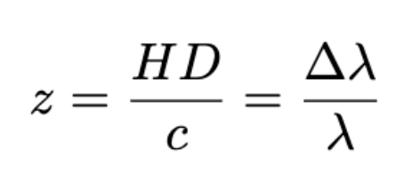
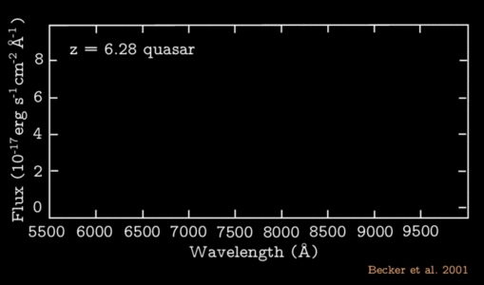
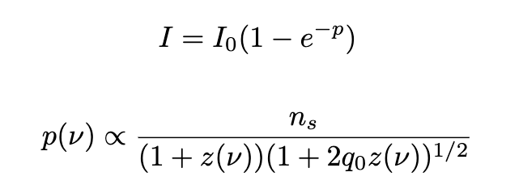
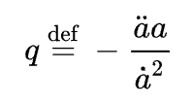
Gunn & Patterson Trough
ns:number density of neutral hydrogen
q0: deceleration parameter

Slide 4
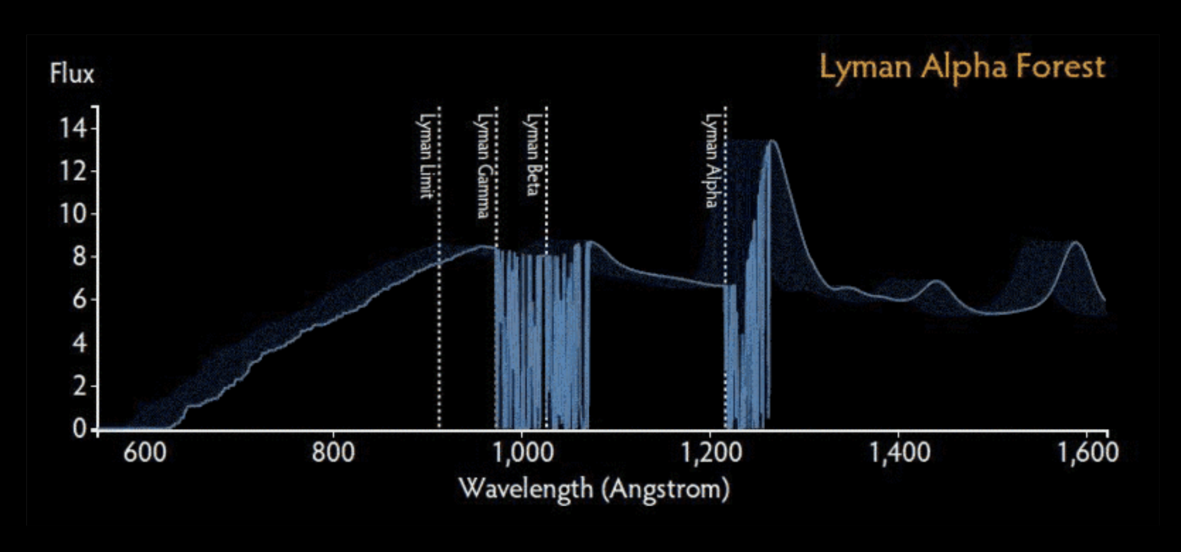
Lyman Alpha Forest (Bahcall & Salpeter )

Slide 5
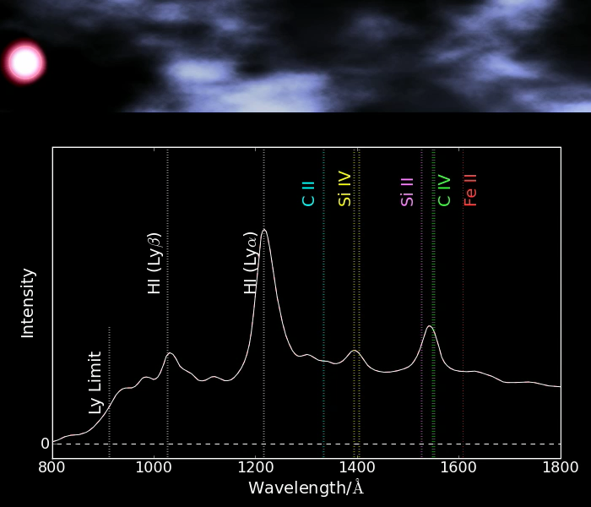
Lyman Alpha Forest

Slide 6
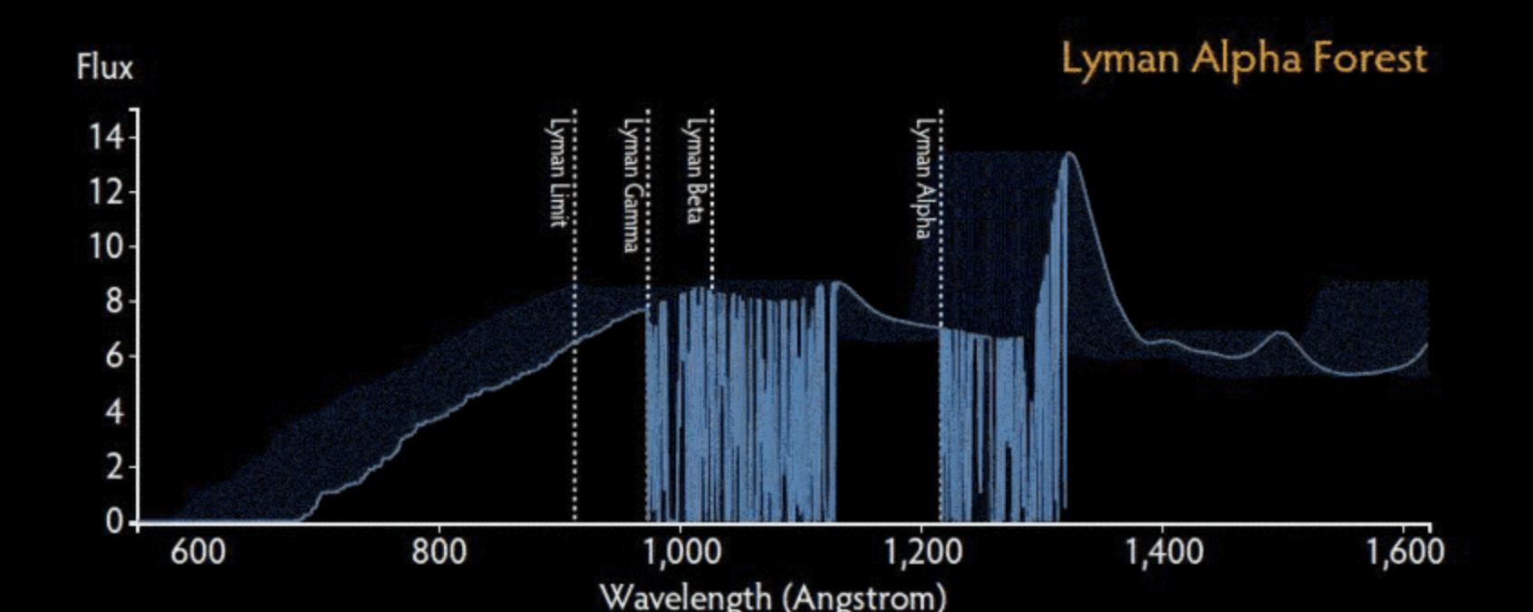
1.Redshift (distance & scale)

Slide 7
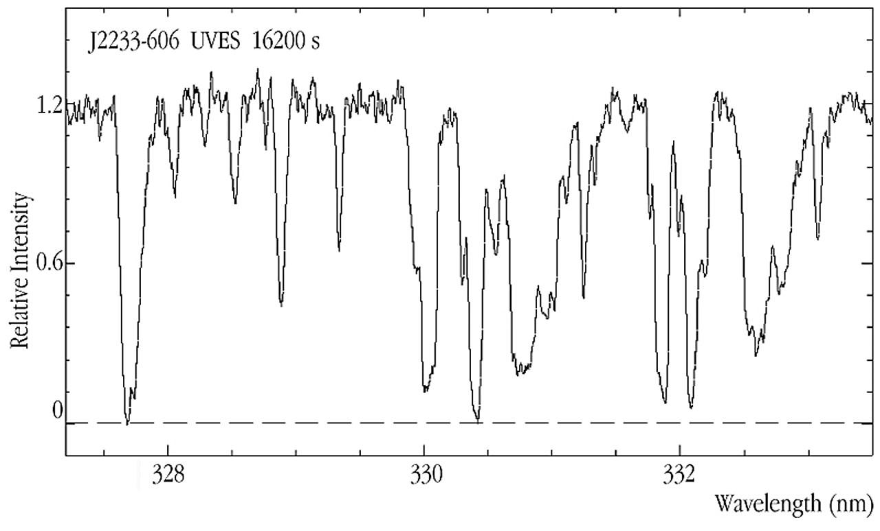
2. Depth (density & mass)
ESO0013

Slide 8
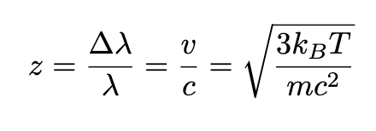
3. Width (temperature & Energy)
ESO0013

Slide 9
4. Neutral Fraction (Do quantum)

Slide 10
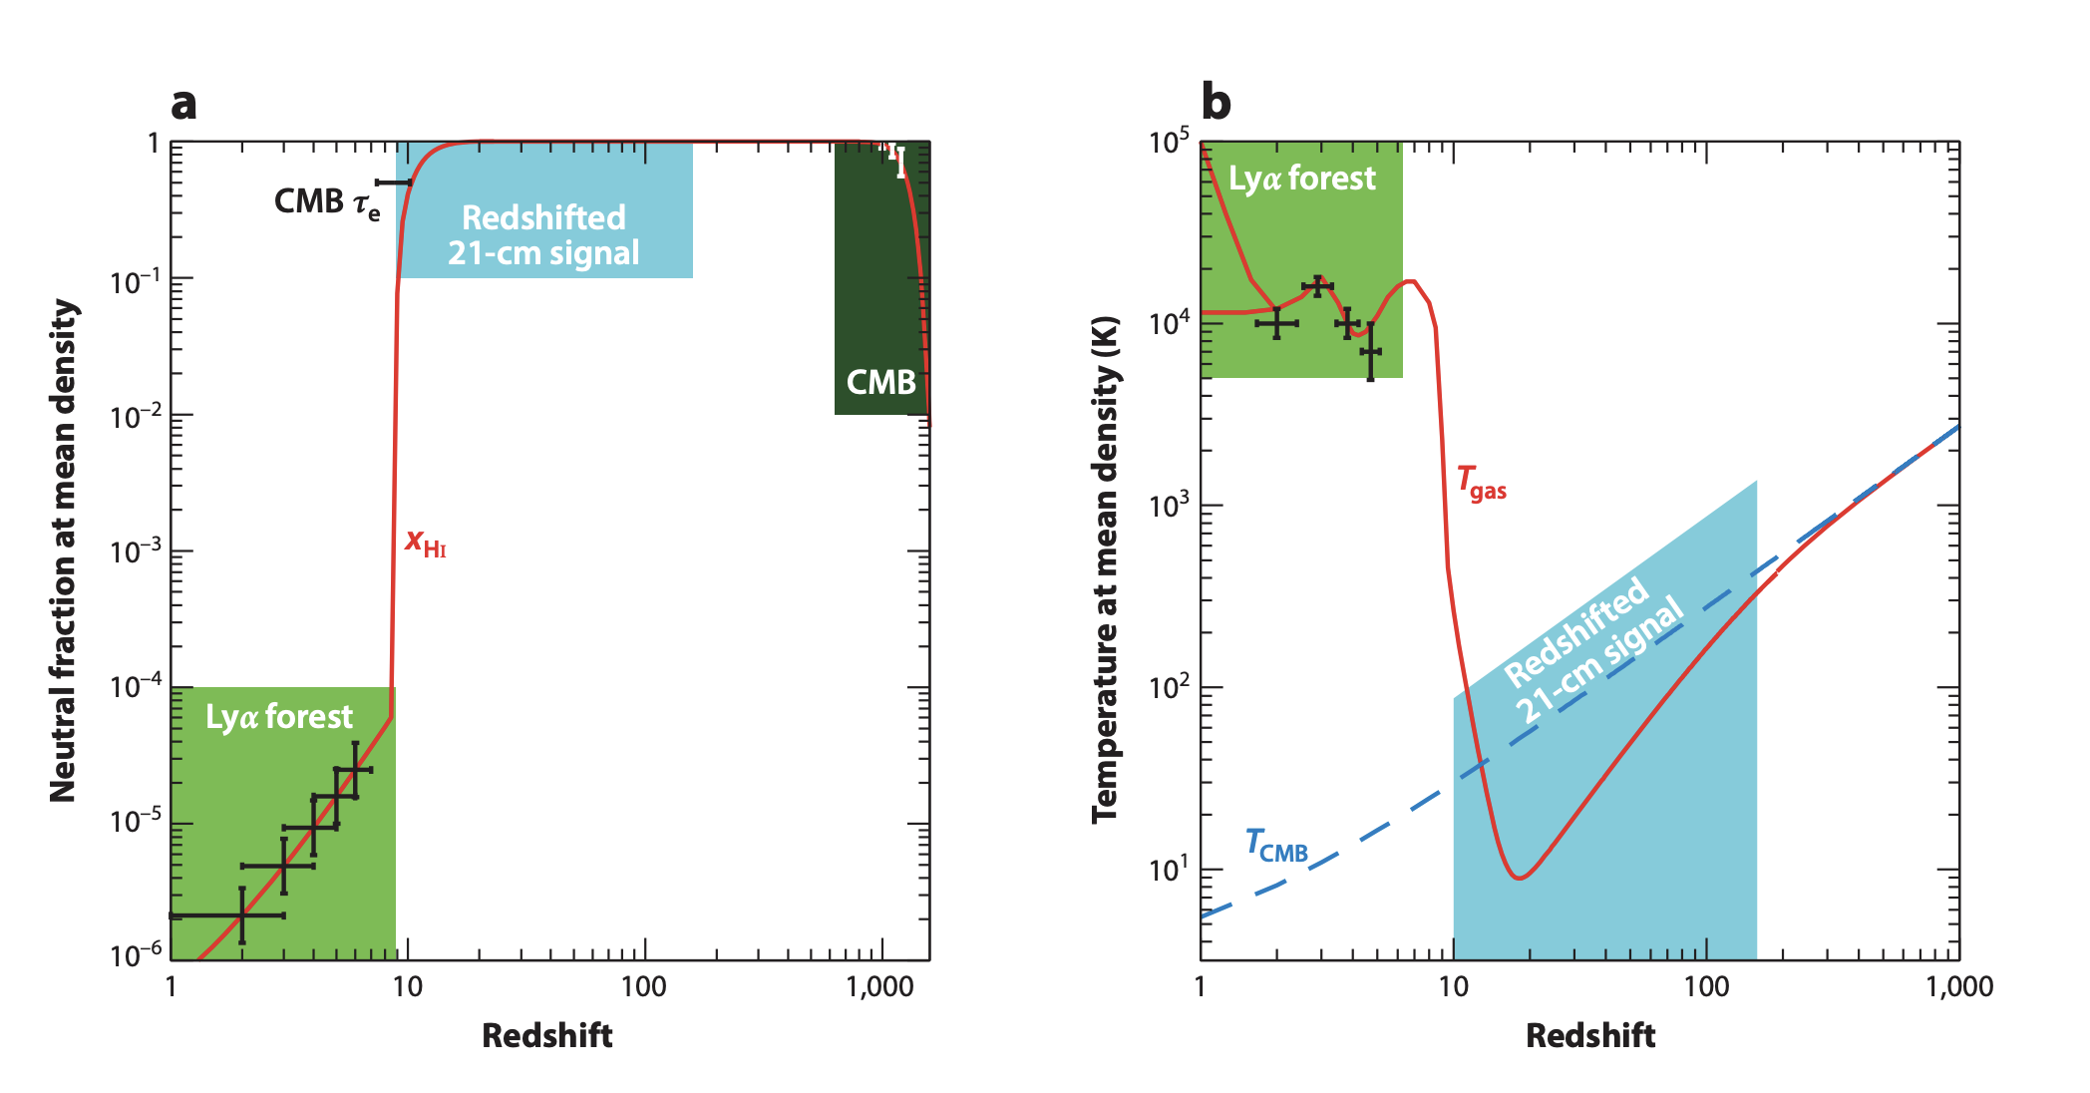
Intergalactic Medium Fun plots
(Matthew McQuinn)

Slide 11
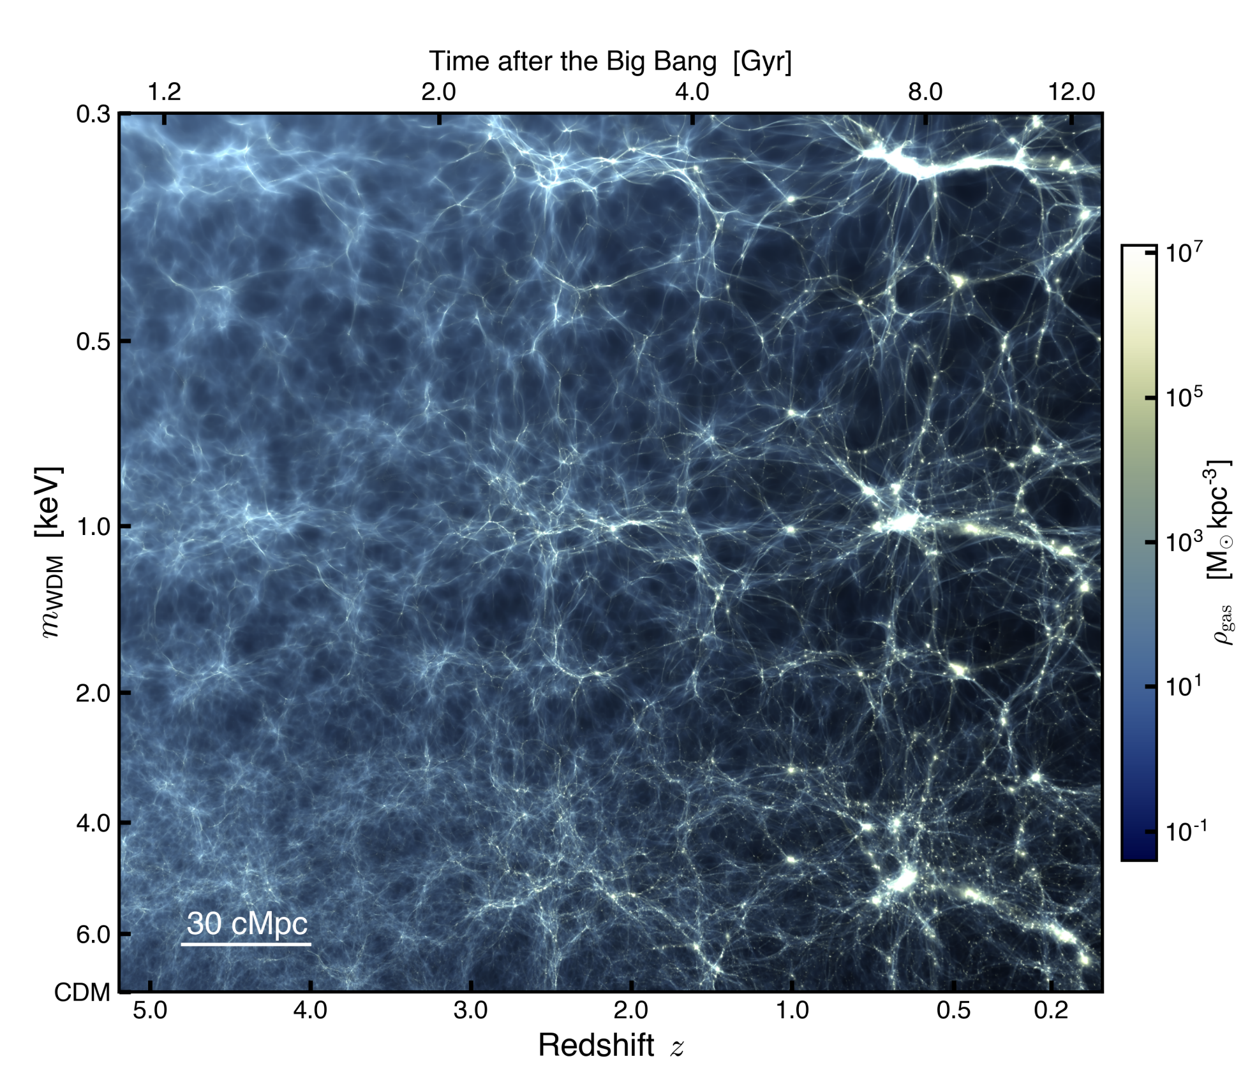
The big structure (Filamentary) (CDM) (Cool done?)
Bruno Villasenor et al
Notes:
Jeans scale: 1/Sqrt[G Rho]
Free Streaming: 1/(n sigma) or <v>

Slide 12
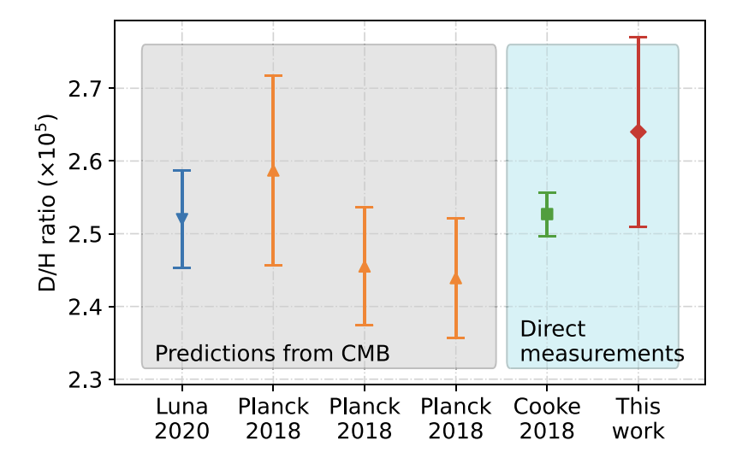
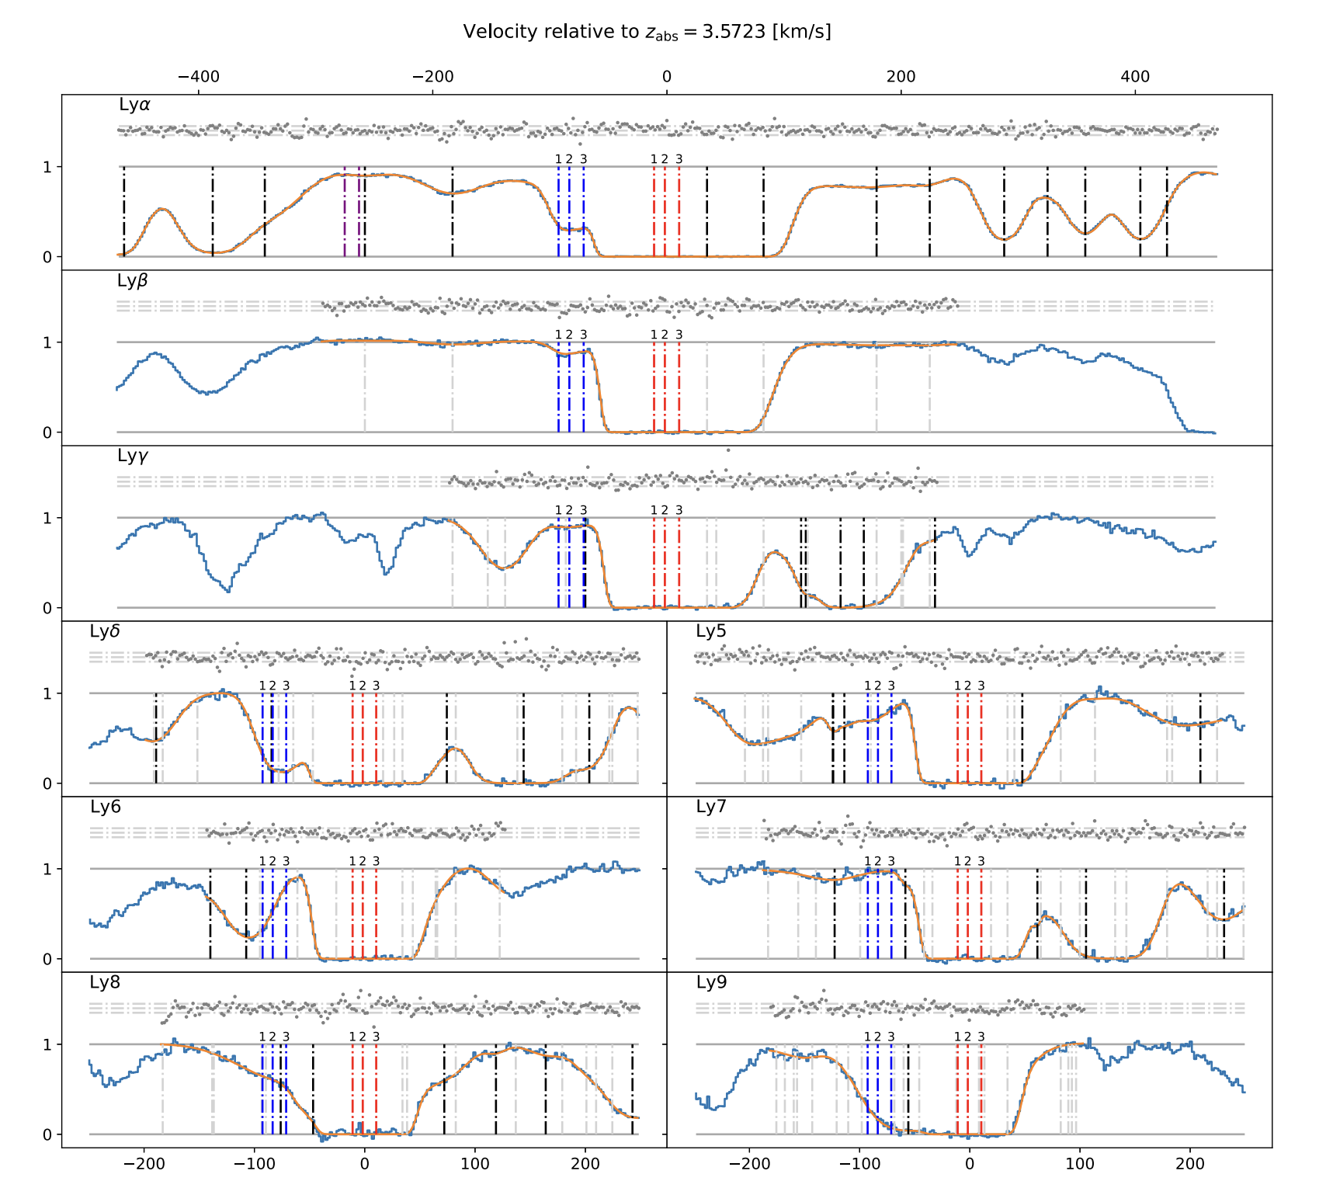
Nucleosynthesis (D/H)
arXiv:2402.05586

Slide 13
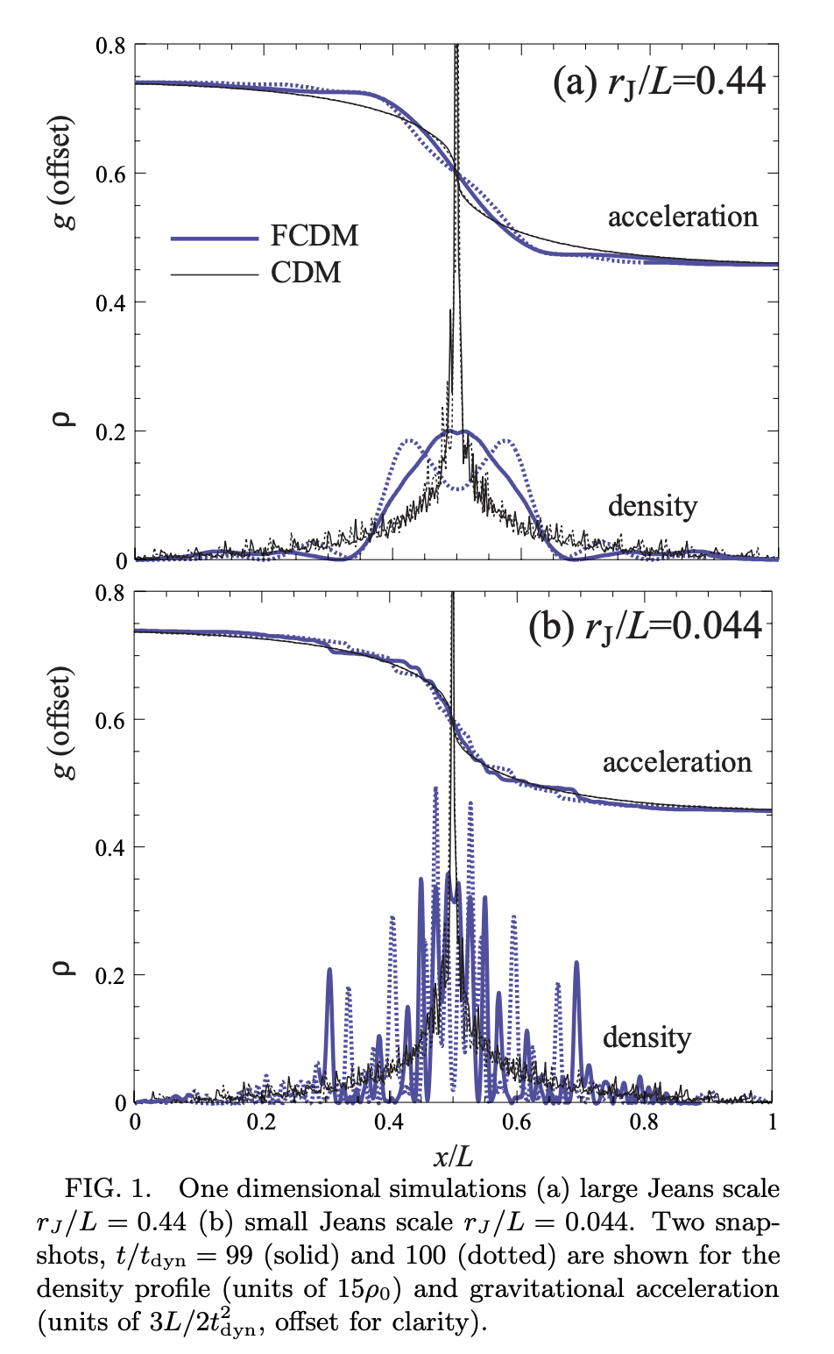
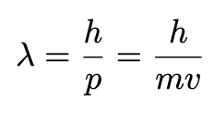
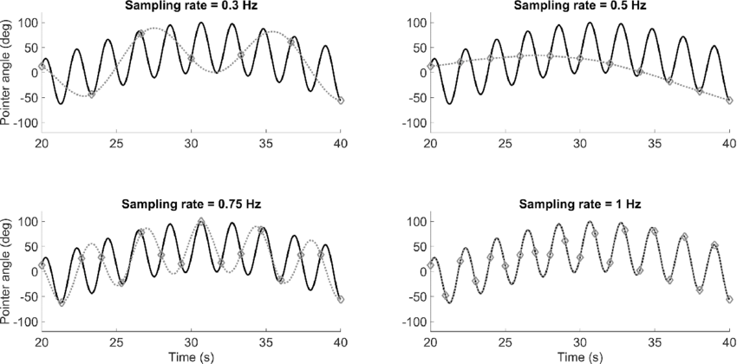
Ultra Light Dark Matter! (21cm forest)
No peak smaller than the de Broglie wavelength!
Arxiv 0003365

Slide 14
Questions

